Slide 1

Department of Computer Engineering
Presentation for SYProject Design (Final Review)
AY 2025-26
“AI Powered legal document analyzer”
Name:
PRN:
Vallabh V Sardesai (202401040041)
Payal V Wani (202401040103)
Tejashri V Kolte (202401040120)
Vedant S Patil (202401040107)
Guide:
Mrs. Kavitha.S

Slide 2
Index
Introduction
Problem Statement
Objectives and Scope
Literature Survey(Important)
Applications(Important)
Algorithm(Important)
Design/Architecture block diagram(Important)
Software/Hardware Requirement
References

Slide 3


Introduction
AI LEGAL LANGUAGE PROCESSOR
Legal professionals deal with huge volumes of complex documents that are difficult and time-consuming to analyze manually.
Nearly 80% of legal professionals say they struggle with the large amount of documents they need to review manually.
HIGHLIGHT KEY CLAUSES
More than 60% of case research time is lost due to scattered and unorganized legal information
AI-based systems can reduce document analysis time by up to 60%, improving speed and accuracy.
DOCUMENT UPLOAD & TEXT EXTRACT
Our system aims to solve these challenges using AI-driven document analysis, semantic search, and case prediction.
ML predicts case outcomes with 75% accuracy.
SIMPLIFY LEGAL TEXT
AI understands legal documents with 90% accuracy.
INFORMED DECISION SUPPORT

Slide 4
Problem Statement
To design an AI tool to simplify complex legal documents, extract key clauses, and flag risks for informed, non-expert decision-making.
Legal jargon and complexity hide crucial terms from the average person.
Misunderstanding contracts creates significant financial and legal exposure for non-experts.
An AI tool can instantly translate complex legal language into simple, plain English.
The system highlights key clauses and essential obligations within any document.
It provides actionable risk alerts for unfavorable or dangerous contractual terms.
This technology empowers users to make confident, informed decisions without a lawyer.
For the Common Man
Democratizes Understanding
Mitigates Personal Risk
Saves Money on Initial Review
Clearly flags and alerts the user to unfavorable terms
For the Lawyer
Automates time-consuming tasks of initial document review
Enhances Focus on Strategy
Scans massive volumes of text with high consistency

Slide 5
Objective and Scope:
Project Objective
Develop NLP models for automated clause extraction.
Accuracy evaluation must reach 70–75% reliability.
Build an AI system that simplifies and explains complex legal documents for users.
Project Scope
In Scope:
Summarization must reduce length by 60–80%.
Ensure data privacy, accuracy evaluation and exclude providing formal legal advice.
Out of Scope:
Providing formal legal advice or interpretation beyond simplification.

Slide 6
 |  |  | Publication Details | Key Findings
2. | AI-Powered Legal Documentation Assistant | P. Vimala Imogen, J. Sreenidhi, V. Nivedha | 2024 | Developed a web-based AI assistant for drafting, editing, and retrieving legal documents using NLP and chatbots. Improves accuracy, speed, and accessibility in legal documentation. Built with HTML, CSS, JavaScript, PHP, MySQL, and CollectChat AI for secure and interactive user experience. Enhances document customization and reduces manual effort.
Title
Author
Sr. NO
This article provides overview of how AI affects legal and human rights issues, including lack of transparency, cybersecurity risks, privacy and data protection, Legal status.it can be solved by identifying and fixing risks early. Involving more people in AI policy decision. We can Make strong laws to protect privacy.
Legal and human rights issues of AI: Gaps, challenges and vulnerabilities
1.
Rowena
Rodrigues
2020

Slide 7
AI tools like chatGPT answers some legal questions, but they are not always reliable as these are wrong or hallucinated (Fabricated). It lacks deep legal understanding. Researchers suggest building AI systems that are more accurate, fair, and ethical. We have to build law specific models from scratch, using LLMs on legal data, train smaller legal models with detailed human feedback
Evaluating AI for Law: Bridging the Gap with
Open-Source Solutions
Rohan Bhambhoria, Samuel Dahan, Jonathan Li, Xiaodan Zhu
3.
18 April 2024
Proposes an AI-driven system to improve legal document management and interpretation.
Compares ML models like Random Forest, CNN, and Decision Tree—Random Forest performs best (≈89% accuracy).
Reduces errors, time, and workload in legal case preparation.
Ensures ethical AI use with focus on transparency and data privacy.
Concludes AI can help accelerate court processes and enhance legal efficiency.
Enhancing Legal Document Management Efficiency: An AI-Powered Solution Addressing Interpretation Challenges
K. Meena, Gangisetty Tanusha, G. Renuka, Kooram Saraswathi, Dr. S. Anuradha
4.
April 2024

Slide 8
 | The State of Legal Tech in India | Manupatra Academy: A pioneer in online legal research in India since 2000 | Survey report In 2025 | 78.4% project AI's main role to be in Legal Research. 76.7% expect AI to reduce time on mundane tasks. 73.7% already have hands-on experience with Generative AI tools. 61.1% name Data Security and Privacy as the biggest barrier. AI hallucination worries 47.9%, mandating human oversight.
 | Artificial Intelligence (AI) in the Indian Legal System | Prof. (Dr.) Surendra Pathak and Dr. Ambuj Sharma | KamKus College of Law September 4, 2025. | AI could cut judicial processing time by 40-60%. Advocates save 70-85% of research time using AI tools. Law firms see a minimum 35% cost reduction via contract automation. Predictive analysis boosts case outcome accuracy to 70-80%. 15-20% of law curriculum must cover AI ethics and technology.
5.
6.

Slide 9
 | Summarizing-Indian-Legal-Documents-A-Comparative-Study-of-Models-and-Techniques | Author-Saloni Sharma. | 4 August, 2023
A study evaluating seven summarization models on Indian court judgments found the following:
Top Performer: The Legal Pegasus model, specifically trained on legal data, was the most effective at summarizing complex Indian court cases.
Transformer Advantage: Transformer-based models like BART, Longformer, and Legal Pegasus significantly outperformed traditional methods (Luhn, LSA, LexRank, TextRank) due to their ability to handle lengthy and unstructured texts.
Domain Specificity Matters: The superior performance of Legal Pegasus confirms that field-specific models trained on relevant legal datasets provide better summarization results than general-purpose models.
7.
Writing legal contracts is a difficult and time-consuming process. This work introduces ClauseREC, an AI-powered system designed to streamline and accelerate contract construction.
The concept is simple: Instead of manual typing, ClauseREC acts as a summarizing "AI legal assistant" by:
Predicting the next required clause type based on the agreement's context.
Retrieving suitable, relevant sample clauses from a vast repository of legal files.
This system saves lawyers significant time, ensures consistency across documents, and reduces the risk of missing critical legal terms.
A Clause Recommendation Framework for AI-aided Contract Authoring
Vinay Aggarwal,
Aparna Garimella.
8.
October 26,
2021

Slide 10
Highlights clauses that may be disadvantageous or pose hidden risks, helping users recognize potential problem areas.
Applications:
Plain-Language Conversion:
Converts complicated legal terminology into easy-to-read, understandable explanations for everyday users.
Automated Clause Detection:
Identifies essential contract clauses (such as confidentiality, termination, liability, etc.) and rewrites them in simplified, user-friendly language.
Risk Identification:
Highlights clauses that may be disadvantageous or pose hidden risks, helping users recognize potential problem areas.
Contract Summarization:
Produces short, clear summaries of lengthy legal documents to save time and improve overall comprehension..
Pre-Consultation Support:
Provides users with a basic understanding of their contract.
Educational Tool:
Helps learners study the structure, purpose, and terminology of legal documents through clear explanations.
Accessibility Enhancement:
Assists users with limited legal knowledge, linguistic challenges, by making legal content more approachable and readable.

Slide 11
Algorithm & Models Of Project
1. BERT ( NLP MODEL )
BERT reads the legal document and captures meaning, context, and relationships between words.
Sources : HUGGING FACE
BERT helps the system understand legal language and context.
Query is transferred to backend and then sent to the BERT-Model
2. Random Forest ( MACHINE LEARNING MODEL )
User Uploads Data or QUERY , Upload Agreement
Before sending data to Random Forest, backend extracts features from the input.
Features Are Passed Into Random Forest
Backend Generates Output , Frontend Displays the Result
3. NER Model ( NAMED ENTITY RECOGNITION )
Random Forest is used for legal prediction tasks : Case outcome prediction , Case category classification
Backend Extracts Features , Backend Passes Features to Random Forest Model
Backend Sends Prediction to Frontend
4. Sentence Transformers
Sentence Transformers help your system understand meaning and find similar text in legal documents.
Meaning-Based Search
Clause Matching in Contracts

Slide 12
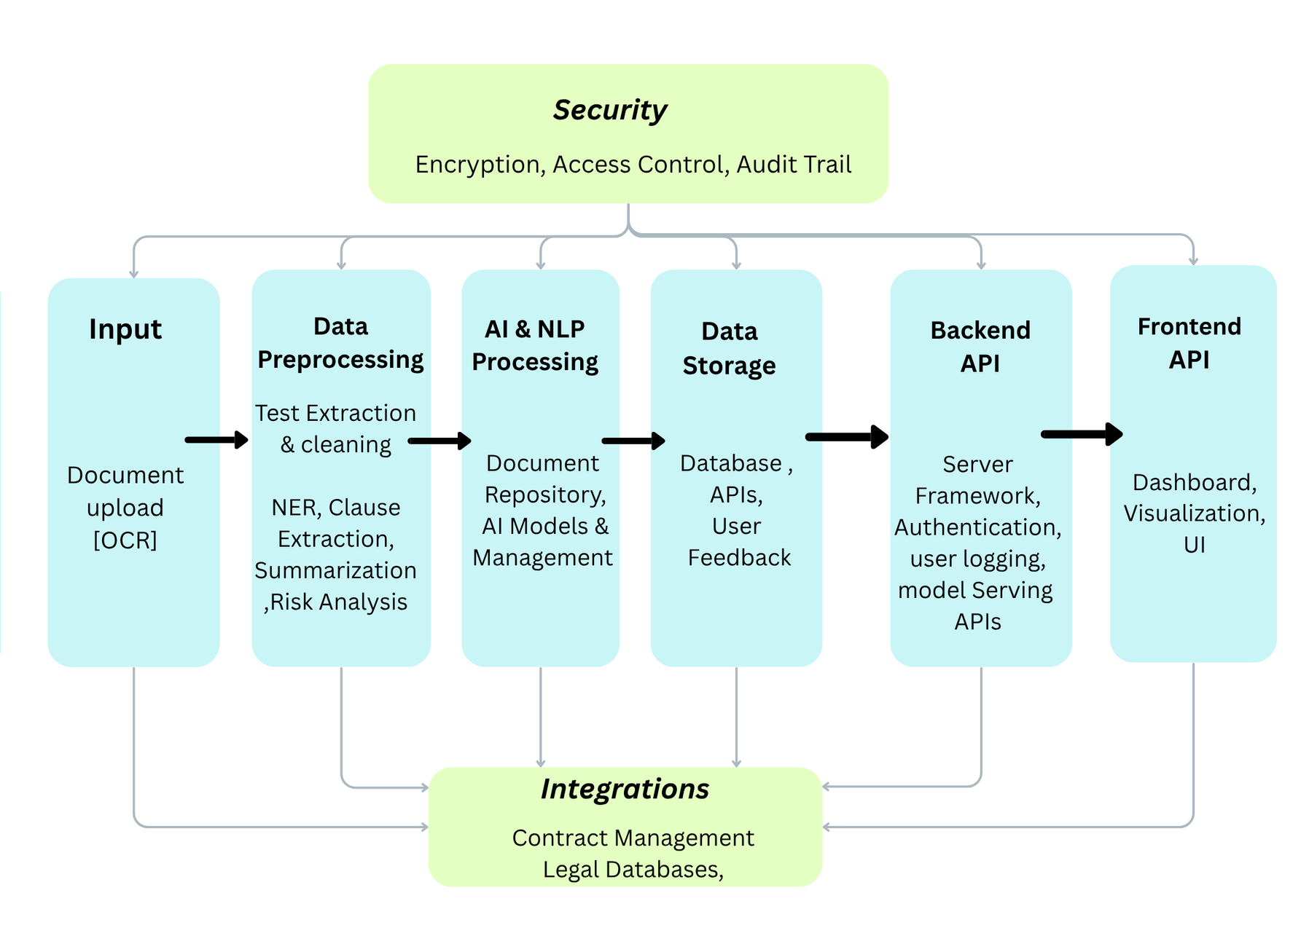
ARCHITECHTURE DIAGRAM

Slide 13
🧰 Software Requirements
Category | Tools / Technologies | Purpose
Operating System | Windows | Development environment
STORAGE / INTEGRATION | AWS CLOUDFRONT / AWS S3 BUCKET | To store the database and help in integration with IDE
Programming Language | Python , JavaScript, CSS, | Core development language for AI/NLP
Machine Learning / NLP Libraries | HuggingFace Transformers, spaCy, NLTK, Scikit-learn, PyTorch, TensorFlow, Github, Kaggle, | Model building, text processing, and training
Web Frameworks | Flask, FastAPI (optional) | For building user interface/API
Database | PostgreSQL ,Mango DB | Store user data or document metadata

Slide 14
📚 References List
https://www.researchgate.net/publication/346305027_Legal_and_human_rights_issues_of_AI_Gaps_challenges_and_vulnerabilities
https://arxiv.org/abs/2404.12349
https://www.semanticscholar.org/paper/Enhancing-Legal-Document-Management-Efficiency%3A-An-Gangisetty-Tanusha/5e2bf7d05e2718b323feb81a9a0682ef0797750f
http://www.manupatracademy.com/assets/pdf/Survey-Report-on-Adoption-of-AI-in-the-Indian-Legal-Landscape.pdf
https://www.researchgate.net/publication/395256349_Artificial_Intelligence_AI_in_the_Indian_Legal_System_Transformations_Challenges_and_Future_Prospects_KAMKUS_COLLEGE_OF_LAW
https://www.researchgate.net/publication/373074828_A_Comprehensive_Analysis_of_Indian_Legal_Documents_Summarization_Techniques
https://arxiv.org/abs/2110.15794
https://www.sciencedirect.com/science/article/pii/S2666659620300056
https://www.researchgate.net/publication/390944755_Advancements_in_legal_text_summarization_integrating_InLegalBERT_for_effective_extractive_summarization

Slide 15
Thank You!!
Any questions.

